Slide 1

(Electronic city campus)
Department Of Mechanical Engineering
MECHANICAL ENGINEERING SCIENCE (MES)
(UE18ME101)
Prof. Sateesh Mudalagi

Slide 2
Unit – 1
Energy Sources and Power Generation

Slide 3
Description of Energy
Form of energy
Various type of Power Plants
Renewable and nonrenewable energy sources

Slide 4
Energy consumption and standards of living
Domestic Sector
Transportation Sector
Agricultural Sector
Industry Sector

Slide 5
Oil Crisis - 1973
OPEC (Organization of Petrol Export Countries Founded in 1960)
Development of Alternative sources
Price of crude oil 19 time more than what it had before oil crisis

Slide 6
Classification of Energy resources
Based on Usability of Energy
a) Primary Resources
b) Intermediate Resources
c) Secondary Resources
Based on Traditional Use
a) Conventional Energy
b) Non-conventional Energy
3. Based on Long time Availability
a) Non- renewable Resources
b) Renewable Resources
4. Based on Commercial Application
a) Commercial Energy Resources
b) Non-commercial Energy Sources
5. Based on Origin

Slide 7
Common Forms of Energy
Mechanical Energy
Electrical Energy
Thermal Energy

Slide 8
Environmental Aspect of Energy
Trade off between Energy and Environment
Ecology
Greenhouse Effect
Consequences of Global Warming
Pollution
Various Pollutants and their Harmful Effects
Green Power

Slide 9
Various Aspects of Energy Conservation
Economic Aspect
Environmental Aspect
Conservation of Non renewable Energy Assets

Slide 10
Principles of Energy Conservation
Recycling of Waste
Modernization of Technology
Waste Heat Utilization
Judicial use of Proper Type of Fuel
Cogeneration
Adopting Daylight Saving Time
Proper Operation and Maintainace

Slide 11
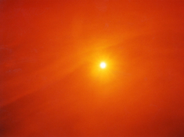
SOLAR RADIATION

Slide 12
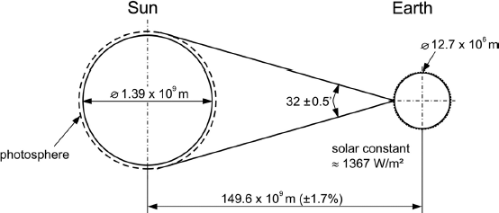
SOLAR RADIATION
Its a clean, inexhaustible, abundantly , universally available.
Radiant energy in the form of electromagnetic waves from sun referred solar radiations
The dia of sun is 1.39 X 10⁹ m, while earth has 1.27 X 10⁷ m, The mean distance between the two is 1.466 10¹¹ m.
Axis of Earth is inclined about 23.5^{O .}
The subtend angle is about 0.53^{O} at the earth’s surface
because of large distance, the beam radiation from the sun on earth is almost parallel.

Slide 13
SOLAR RADIATION
Solar energy is created at the core of the sun when hydrogen nuclei are converted to helium nuclei through a number of intermediates.
For each second of the solar nuclear fusion process, 700 million tons of hydrogen is converted into the heavier atom helium.
The solar nuclear process creates immense heat that causes atoms to discharge photons. Temperatures at the core are about 15 million degrees Kelvin

Slide 14
SOLAR RADIATION
Sun surface temperature is 5,778 K
3.8×10²⁶ J, total energy output of the Sun each second,
5.5×10²⁴ J, (1.74 X 10 ¹⁷ j/s)total energy from the Sun that strikes the face of the Earth each year.

Slide 15
Extra-Terrestrial radiation
Solar radiation incident outside the earth's atmosphere is called extraterrestrial radiation.
The distance between sun and earth varies a little through the year. Because of this variation, extra terrestrial flux also varies.
30% reflected back to space, 23% is consumed for hydrological cycle. 47% is absorbed by atmosphere.

Slide 16
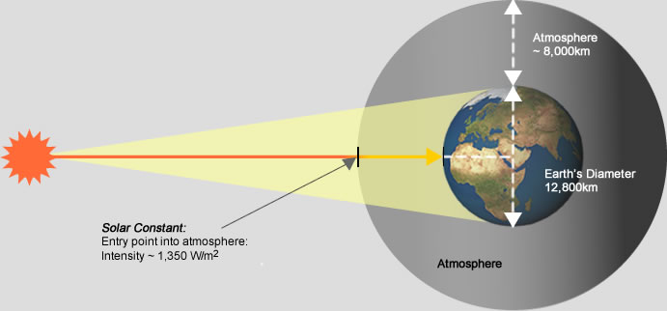
Extra-Terrestrial radiation

Slide 17
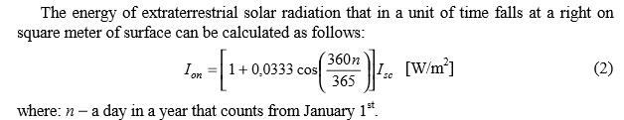
Extra-Terrestrial radiation
I _{sc} = solar constant = 1367 W/m2

Slide 18
Solar constant
The solar constant, a measure of flux density, is the amount of incoming solar electromagnetic radiation per unit area that would be incident on a plane perpendicular to the rays, at a distance of one astronomical unit (AU) (roughly the mean distance from the Sun to Earth, 149,597,890 km ).
The "solar constant" includes all types of solar radiation, not just the visible light. Its average value was thought to be approximately 1.370 kW/m²

Slide 19
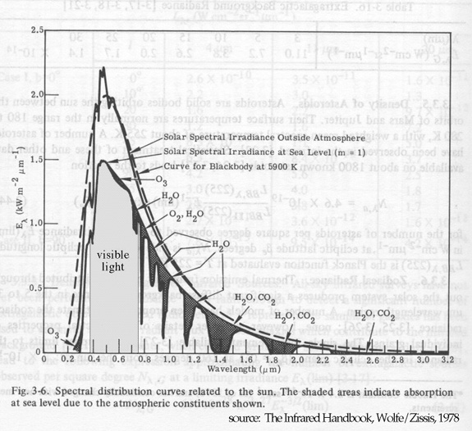
SPECTRAL DISTRIBUTION OF ETR

Slide 20
SPECTRAL DISTRIBUTION OF ETR
Radiant energy from sun is in electromagnetic nature.
99% have wave length in range of 0.2 to 4.0 micrometer.
Solar energy reaching the top of the earth atmosphere consist of about 6.5% of UV (short wave length, less than 0.39µm)
48% visible light (0.39µm to 0.78µm)
45.6% of infrared radiation (wave length more than 0.78µm)

Slide 21
SOLAR RADIATION AT THE EARTH’S SURFACE
Radiation received on earth surface is different from above atmosphere.
Differs in amount and character.
In view point of harnessing solar energy, energy received at earth surface is more important than above atmosphere.
Radiation form received at surface of earth is referred “solar radiation at the earth’s surface/ terrestrial radiation.”
Atmosphere contains : ozone, oxygen, nitrogen, carbon dioxide, carbon monoxide, water vapour, water droplet and dust.

Slide 22
SOLAR RADIATION AT THE EARTH’S SURFACE
ABSORPTION- Selective absorption of various wavelength radiation.
Less than 0.29 µm and greater than 2.3 µm absorbed in atmosphere. Between these two significant for terrestrial application
Ozone :- significant amount of UV
Nitrogen, oxygen and other atmospheric gases:- X ray, extreme UV.
Water vapour and carbon dioxide :- λ › 2.3 µm (almost completely)
Dust particles : - irrespective of wavelength.
The absorbing of radiation increases the energy of molecules and hence rise in temperature.

Slide 23
SOLAR RADIATION AT THE EARTH’S SURFACE
Scattering
Scattering by dust particles and air molecules.
part of the radiating penetrating in to atmosphere get reflected back to space especially by clouds.
Another part is absorbed by clouds,
Earth reflects about 30% of radiation falling on it. (albedo)

Slide 24
Direct radiation: the radiation not been absorbed or scattered and reaches the ground directly from sun. (also called Beam radiation)
This radiation produces shadow.
Diffuse radiation : radiation received after scattering and reflection.
Diffuse radiation comes from all the parts of the sky.
Insolation/ global radiation: sum of direct and diffuse radiation

Slide 25
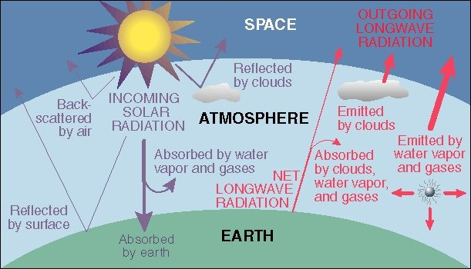

Slide 26
Solar Energy Conversion
Heliochemical process: Photosynthesis
Helioelectrical process: photovoltaic cell
Heliothermal process: solar water heater, solar pond etc...

Slide 27
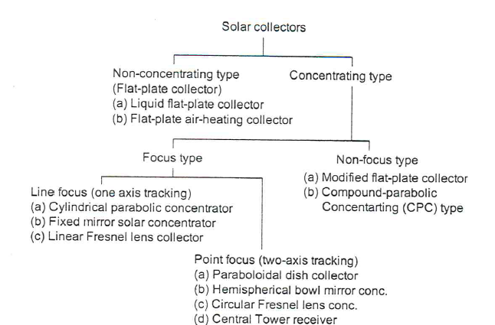
SOLAR COLLECTORS

Slide 28
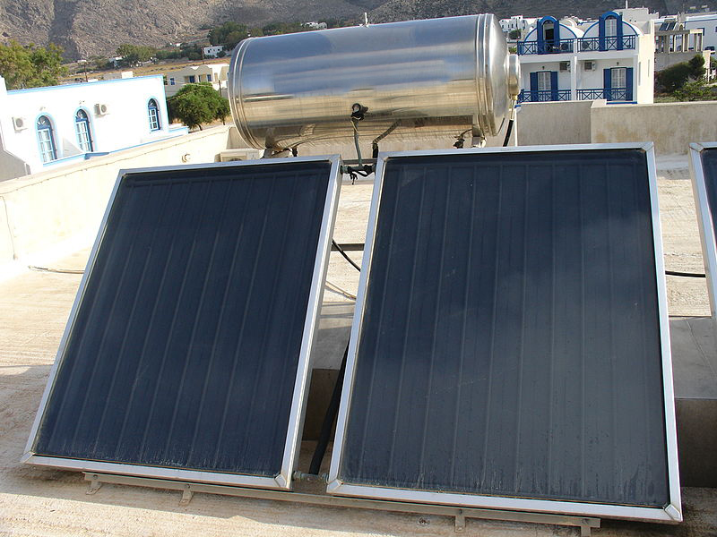
FLAT PLATE COLLECTOR

Slide 29
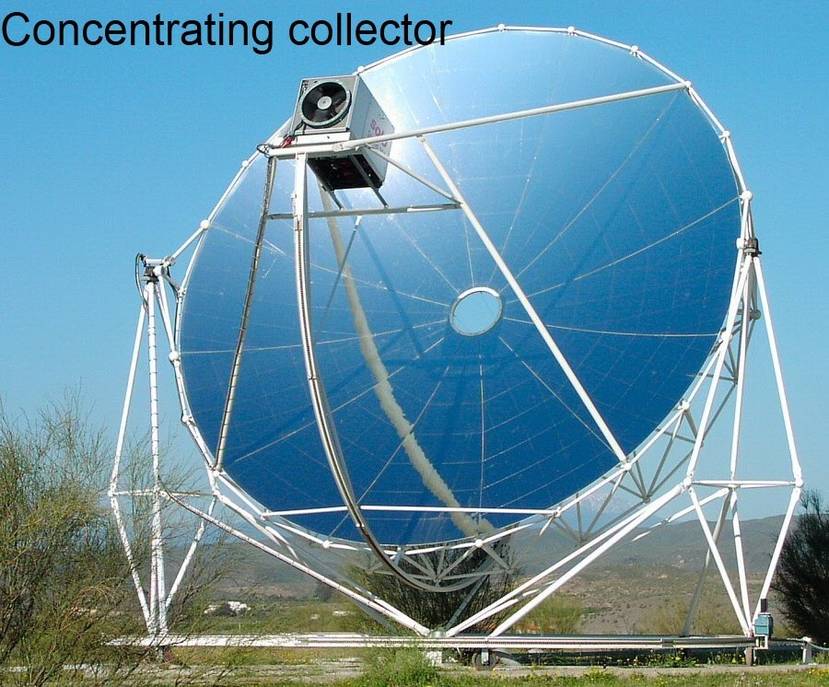

Slide 30
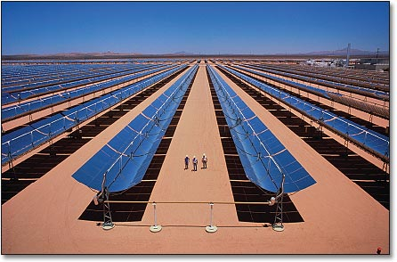

Slide 31
COMPARISON
Concentrating
Non concentrating
Only beam radiation.
Tracking mechanism required.
More maintenance
Can attain high temperature, due to concentration of solar radiation and less loss to surrounding.
Both diffuse and beam radiation.
Tracking mechanism not required.
Less maintenance
Cannot attain high temperature as radiations are not concentrated and more loss to surrounding.

Slide 32
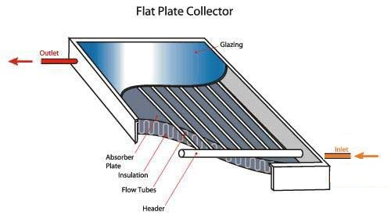

Slide 33
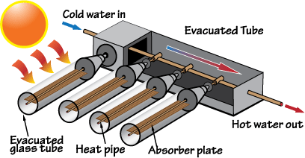

Slide 34
SOLAR COOKER
Box type
Paraboloidal Dish type
Community type
Advanced solar cooker

Slide 35
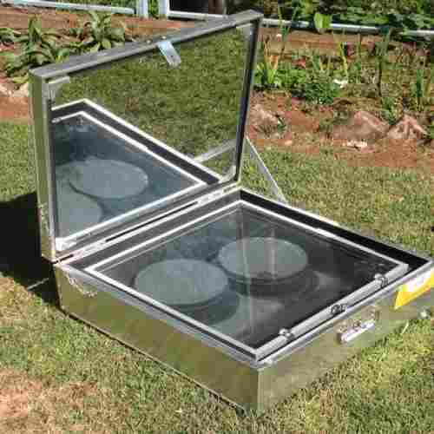
Box type solar cooker
2kg of food, 2-3 hrs, 140⁰ - 160⁰ C, 3 – 4 cylinders per year.

Slide 36
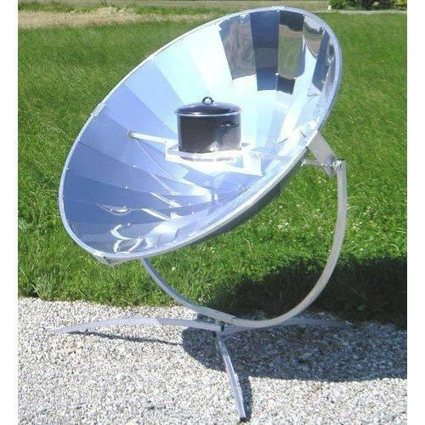
Paraboloidal Dish type
Up to 450⁰ C, 20 to 30 minutes, can save up to 10 Cylinders (family of 10 – 15)

Slide 37
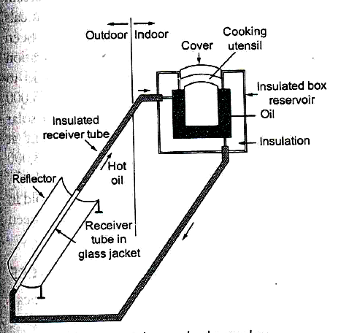
Advanced solar cooker
Stores the thermal energy (heat), cooking is possible even when sun is not available.
Reservoir should be placed higher than collector, so that, natural circulation is set up.

Slide 38
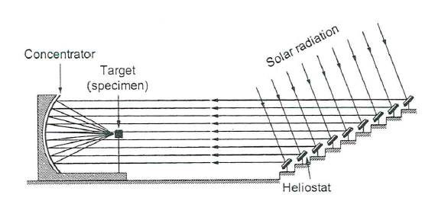
SOLAR FURNACE
Ideal for chemical, optical, electrical and thermodynamic properties of material at
high temperatures .
Advantages: heating without contamination, easy to control temperature, high heat flux,
Absence of electromagnetic field, continuous observation possible.
Disadvantage: limited to sunny days (4 to 5 hrs), high cost, heat small area,

Slide 39
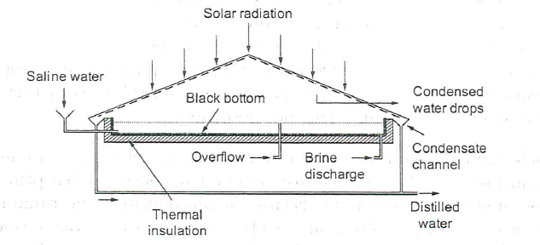
SOLAR DESALINATION
Because of industrialization and the population explosion- demand for fresh water,
Decrease in rain fall another cause.(
79% salty, 20% brackish(less salt). 1% fresh water.
called solar stills.
Idea was first applied in 1872 at Las Salinas, Chile to supply fresh water for animals in mining areas.

Slide 40
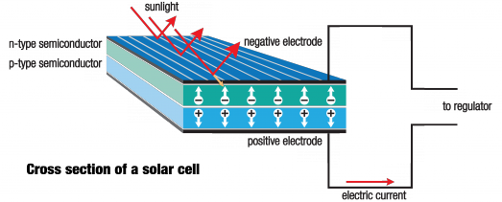
SOLAR CELL

Slide 41
SOLAR CELL
The basic conversion device, that converts light (solar) to electrical energy call solar photovoltaic cell or solar cell.
first developed in 1954, initially major application was space, with the oil crisis, terrestrial application were considered.
Special application, Highly efficient – 46%, commercial – 15 to 20%.
Each cell - voltage of approximately 0.5 to 0.6 volts.
Major application were - space satellites, remote radio communication booster station, marine warning lights etc.
Recent application – lightning, traffic signal management systems, water pumping (KUSUM - Kisan Urja Suraksha evam Utthaan Mahabhiyan) scheme by Govt. of India. (40% of cost by formers ).
Solar powered vehicles, battery charging.

Slide 42
ADVANTAGES
No moving parts, life of each panel is about 20 years
Reliable, modular (standard units), durable and maintenance free.
Systems are quite, compatible, instantaneous response.
Can be installed at the place of use.
DISADVANTAGES
Expansive,
Low efficiency, less solar density area- more space, large number of cells needed .
Intermittent in nature, need storage system (so costs more)

Slide 43
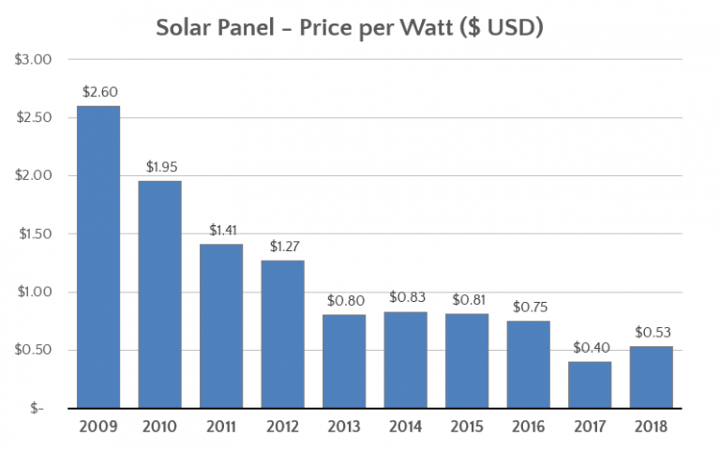
SOLAR PANEL PRICE
In 1971- $100/watt

Slide 44
Karnataka Solar Power Projects
5172.72 MW – commissioned capacity
9000 MW alloted capacity,
Pavagada Solar Park is a solar park spread over a total area of 13,000 acres (53 km²) in Pavagada taluk, Tumkur district, Karnataka. 600 MW of power was commissioned by 31 January 2018. and a further 1,400 MW are planned. The total investment required to build 2,000 MW of capacity was estimated at ₹14,800 core (US$2.2 billion). By the end of 2018, the park is planned to have a total capacity of 2,000 MW and will be the world's biggest solar farm.

Slide 45
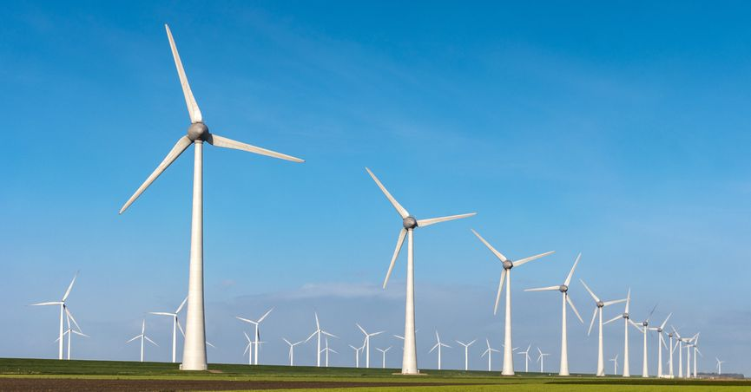
WIND ENERGY
Kinetic energy associated with large mass of moving air – wind energy
Uneven heating of earth surface, uneven heating of earth surface and local water body, rotation of earth – formation of wind.
1% of solar energy falling on earth converted in to wind- indirect for of solar energy.
2000 to 1700 BC – china- water pump, grind grains.
Egyptians – 5000 years ago, sail ships.
Europeans - first to use horizontal axis wind mills,

Slide 46
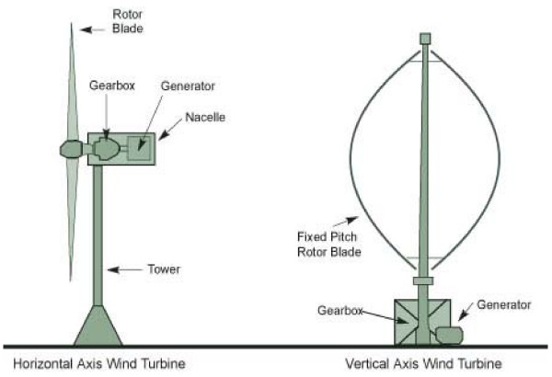

Slide 47
By 1750- Holland had 8000 wind mills,
England had 10000 wind mills,
Usage decreased with the invention of steam engine – James Watt,
Further decreased with design of IC engines, Steam and gas turbines.
With the depletion of fossil fuels ad oil crisis in 1973- regain importance.

Slide 48
Available through out the day (not like solar energy)
Its clean, cheap and eco-friendly renewable energy.
Disadvantage – dispersed, erratic (no regular patterns), location specific source.
5 m/s to 25 m/s are considered favourable.
Generator coupled with wind turbine called aero-generator.
Global potential in winds for large scale grid-connected power generation has been estimated 9000 TWh/year.
Suitable for small scale applications like wind pumps, battery chargers, heaters etc.
In1980 – Rs 17 per kWh and Rs 2.50 per kWh at present.
4 Cr / MW plant (less than or almost equal to thermal power station)
Payback period is one year
By 2030- estimated to have 20% of world demand through wind energy.

Slide 49
MAJOR APPLICATION
Applications Requiring Mechanical Power
Pumping of water- wind pumps – remote areas.
(domestic supply, small scale irrigation, aquatic breeding etc..)
Heating (space heating, mechanical to heat energy with peddle wheel and turbulent fluid)
Sea transport (use of drag force)

Slide 50
Off-Grid Electrical Source.
diameter of 3m, 40 to1000 W (domestic applications including space heating)
Up to 50 kW, Navigation signal, remote communication, weather stations, offshore oil drilling platforms.
100 kW to 250 kW – isolated population, farm cooperative, commercial refrigeration and small scale industries
Stand alone mode or connected to mini-grid system.
Pumped storage plant.
Grid connected power source (major application) few kW to MW, array of aero-generators know as wind farms

Slide 51
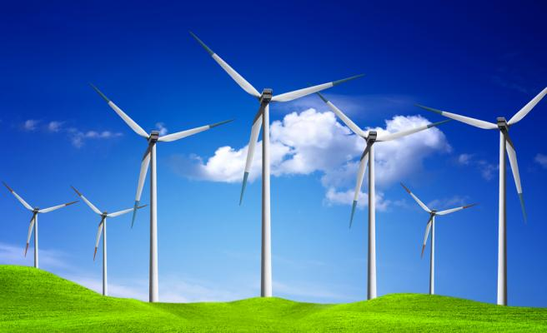
WIND FARMS

Slide 52
Muppandal is a small village in Kanyakumari District of Tamil Nadu and one of the most important site of wind farm in the state. It uses wind from the Arabian Sea to produce renewable energy with the total capacity of 1500MW which is the largest in India.
Jaisalmer Wind Park is the largest operational onshore wind farm in India,located at Amarsagar in Jaisalmer district of Rajasthan. Its installed capacity of 1,064 MW which makes it one of the largest wind farms in the world and largest of its kind in India.
Brahmanvel Wind Farm Dhule, Maharashtra.
Damanjodi Wind Farm, Odisha

Slide 53
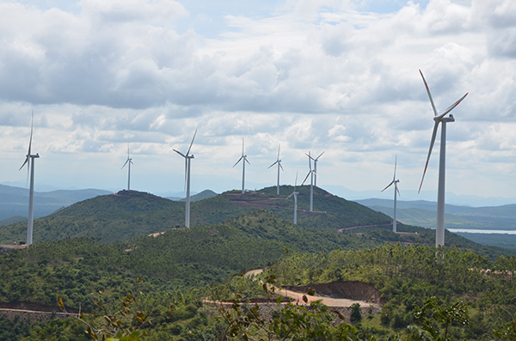
Tuppadahalli Wind Farm , Karnataka
Tuppadahalli wind park is located in the state of Karnataka, located about 55km from Chitradurga and 260km from Bangalore. 56.1MW power project produces 140GWh of clean energy per annum, The state of Karnataka is rich in wind farms compared then other states of India.

Slide 54
Wind power = density X area of sweep wind blades X velocity3
Max efficiency – 59% - Betz law (or limit)

Slide 55
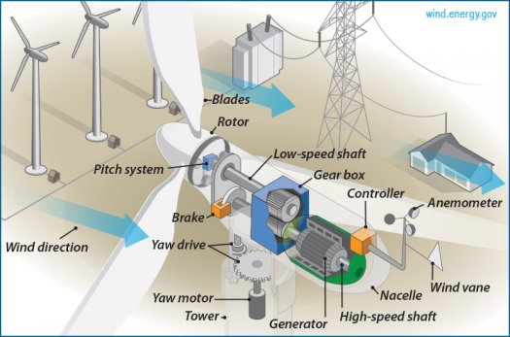
Wind Energy Conversion System

Slide 56
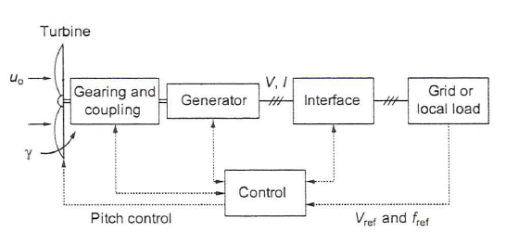
DC Generator – conventional not recommended, permanent – Magnet are considered for low power plant,
Synchronous generators with reluctance motors are considered.
Induction generators are extensively used.

Slide 57
GEOTHERMAL ENERGY
25-30 degree C, per km.
Heat energy in earth (radioactive decay of materials, since from the formation of earth).
Volcanoes, geysers, hot springs and boiling mud pots are the visible evidence of great reservoir of heat.
Although large amount of heat (2.2 X 10^25 j below 10km, 350000 years of supply), low grade energy.
Limited to few sites.
Low temperatures sites used as spa (3 BC china), space heating, cooking etc.

Slide 58
50°C to 70°C – direct thermal application.
> 90°C, electric power generation .
As of 2015, worldwide geothermal power capacity amounts to 12.8 gigawatts (GW), of which 28 percent or 3,548 megawatts (90% in California) are installed in the United States. International markets grew at an average annual rate of 5 percent over the three years to 2015, and global geothermal power capacity is expected to reach 14.5–17.6 GW by 2020.
6-10 crore per MW generation. Costs 2 to 3.50 per kWh

Slide 59
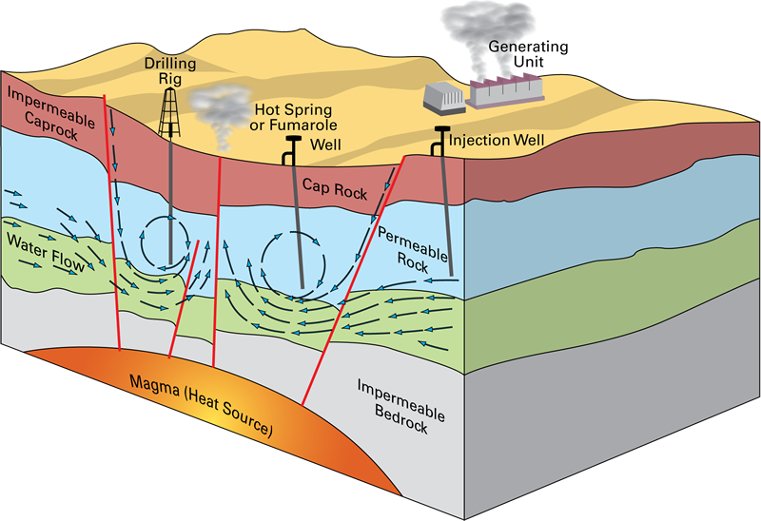
GEOTHERMAL ENERGY

Slide 60
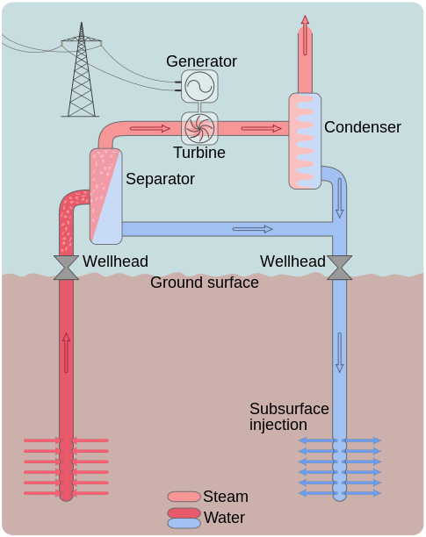

Slide 61
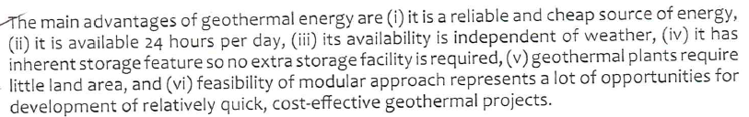
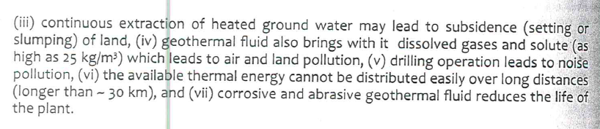
Advantages And Disadvantages

Slide 62
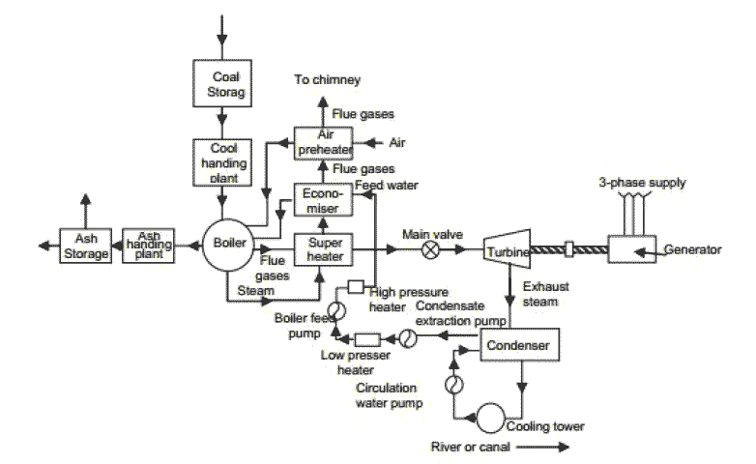
THERMAL POWER PLANT

Slide 63
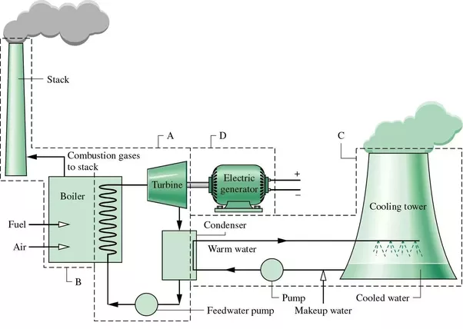

Slide 64
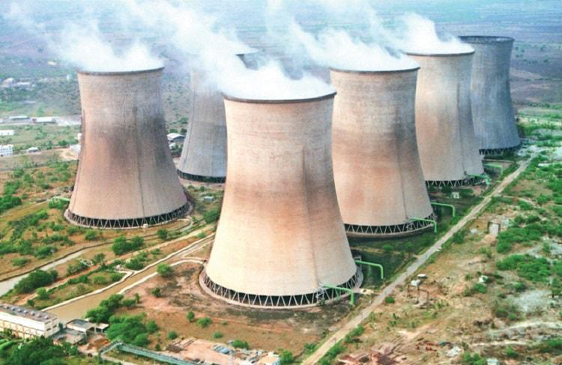
COOLING TOWERS

Slide 65
Electric Energy by Coal
326,832.53 MW capacity all over India
60.13 % (192,162.88) is by coal
117 places, 432 plants –Central, state and private owned.
Mundra Ultra Mega Power Project – TATA power – Kutch – 4000 MW
Mundra Thermal Power Station – Adani powers – Kutch – 4620 MW.
Vindhyachal Super Thermal Power Station – NTPC - Singrauli (MP)- 4760 MW
Sasan Ultra Mega Power Project – Reliance Power - Singrauli (MP) – 3960 MW
(https://en.wikipedia.org/wiki/List_of_power_stations_in_India)

Slide 66
Thermal Power Plant in Karnataka
Raichur Thermal Power station, 7 + 1 units, 7x210 + 1x250 = 1720 MW
Bellary Thermal Power station , 2 + 1 units, 2x500 + 1x700 = 1700MW
Yermarus Thermal Power Station 2units, 2x800 = 1600 MW
Udupi Thermal Power Plant, Udupi Karnataka 2 x 600 = 1,200 MW (phase 2 , 1600MW under Construction)
JSW Vijayanagar Power Station, Vijayanagar Bellary, 6 units, 1460 MW,

Slide 67
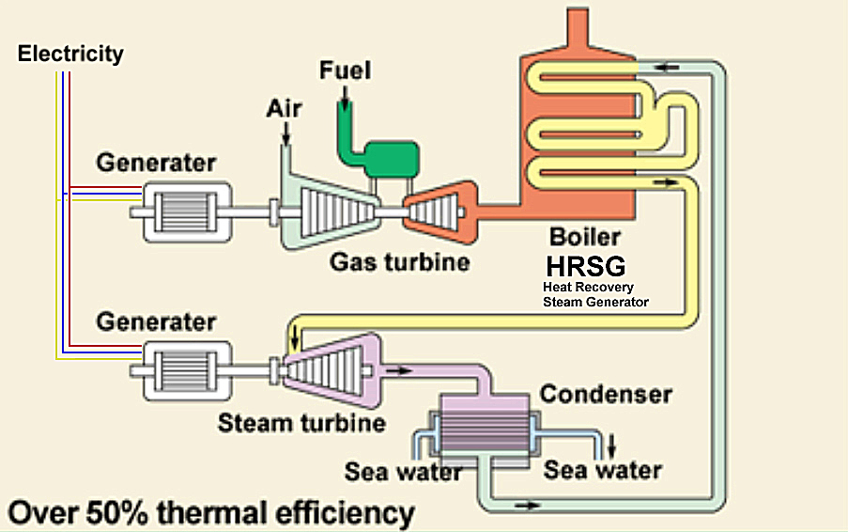
THERMAL POWER PLANT (GAS)

Slide 68
THERMAL POWER PLANT (GAS)
25,329.38 MW (7.9% of total power)
Dabhol Power Station - 2,220 MW capacity, which was a joint venture of Enron, General Electric, Bechtel and Maharashtra Power Development Corporation. (₹ 4.67, expensive)

Slide 69
Mini, Micro Hydro Source
Small Hydro Plants (SHPs) – less head (< 40 m) and small capacity.
In India < 25 MW called SHPs
They are considered to be non-conventional, as they built after 1973 (oil crisis)
>1 kW and < 1 MW called Micro Hydro Plants.
Micro Hydro plants are built in remote areas where main grid does not exist.
Typically, power supply to one rural industry or one rural community with power output as small as 200 W.
Sometimes small contribution to national grid.

Slide 70
Mini, Micro Hydro Source
Classification-
Storage type
Small dam and small reservoir
Run-of-the-river
Direct the water from main flow with channel or pipe and then through turbine.

Slide 71
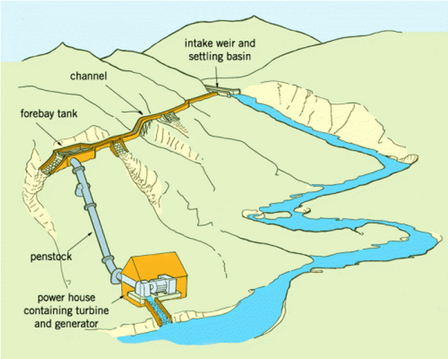
Run-of-the-river -no reservoir or dam

Slide 72
Most of the Micro hydro schemes are of run of the river type.
Disadvantage – flow rate of water may not be same in all the seasons.
Advantages
Can be built locally in low cost.
Environmental damage is negligible.
Ecology not affected.

Slide 73
Energy from Biomass
Biomass – plants(including agricultural wastes), animals (dung or manure), fungi, bacteria.
Energy obtained from biomass is called Biomass Energy
Estimated that, (1/8)^{th} of total biomass produce would be sufficient to meet current energy demand.
its renewable energy (plants can be re-grown).
Photosynthesis is primarily responsible for biomass - indirect form of solar energy.
average efficiency of photosynthesis is 0.5% to 1%.

Slide 74
Energy from Biomass
Direct combustion.
Pyrolysis- charcoal (removing moisture and volatile constituents)
Anaerobic digestion – biogas.
Fermentation – Ethanol (glucose from sugar ie sugar cane etc).
Gasification – combustible gas.

Slide 75
Advantages
Renewable source of energy.
Indigenous source of energy- no foreign exchange.
Pollutant emission from biomass is less than fossil fuels.
Commercial use of energy from biomass may reduce or avoid disposal wastes. (Municipal solid wastes).
Use of biogas plant, supply of clean gas and sanitation.
Nitrogen rich bio-digested slurry from biogas plant- improves fertility of agricultural soil.
Any capacity can be installed, no seasonality involved.

Slide 76
Disadvantages
Dispersed- land intensive source.
Low energy density. (few kJ/kg to MJ/kg)
labour intensive (expensive)
Not suitable to set up at all locations (especially in urban areas).
Not suitable for varying loads.

Slide 77
Fuel Cell
Emerging technologies : Fuel cell and hydrogen energy.
Fuel cell: Device converts chemical energy of fuel to electrical energy (with out combustion).
The principle of fuel cell discovered in 1838 by German scientist Christian Friedrich Schonbein.
Based the principle in 1839 fuel cell was demonstrated Sir William Robert Grove.
Not used extensively because of highly expensive.

Slide 78
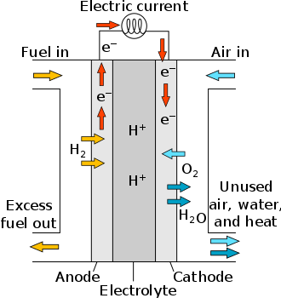
Fuel Cell
Anode reaction: 2H₂(g) → 4H⁺ + 4e‾
Cathode reaction: O₂(g) + 4H⁺ + 4e‾ → 2H₂O
Overall cell reaction: 2 H₂ + O₂ → 2H₂O

Slide 79
Average cell voltage is 0.7V, (current depends on electrode area)
For more power several cells may be connected in series (for more voltage)and parallel (for more current).
Should not confuse with battery.

Slide 80
Types of fuel cells
Based on type of Electrolyte and fuel use.
Proton exchange membrane fuel cell.
Phosphoric acid fuel cell (PAFC)
Solid acid fuel cell (SAFC)
Alkaline fuel cell (AFC)
High-temperature fuel cells.
Electric storage fuel cell.

Slide 81
ADVANTAGES
Static device.
Quite in operation.
Less pollutant.
Very high conversion efficiency (40 to 60% and with CPH up to 85%)
Plant can be at point of use.
No cooling water is required.
Modular – any capacity can be built, and can be extended with demand.
Compact- less auxiliary equipments.
High efficiency at low or part loads.
Disadvantage – Expensive, storage of hydrogen.

Slide 82
Applications
Power- Stationary fuel cells are used for commercial, industrial and residential primary and backup power generation.
Cogeneration- Combined heat and power (CHP) fuel cell systems are used to generate both electricity and heat for homes, office building and factories

Slide 83
Fuel cell electric vehicles- As of 2017, about 6500 FCEVs have been leased or sold worldwide.
Three fuel cell electric vehicles have been introduced for commercial lease and sale: the Honda Clarity, Toyota Mirai and the Hyundai ix35 FCEV. Additional demonstration models include the Honda FCX Clarity, and Mercedes-Benz F-Cell.

Slide 84
Energy from Ocean
Wave energy.
Tidal Energy
OTECs- Ocean Thermal Energy Conversion systems.

Slide 85
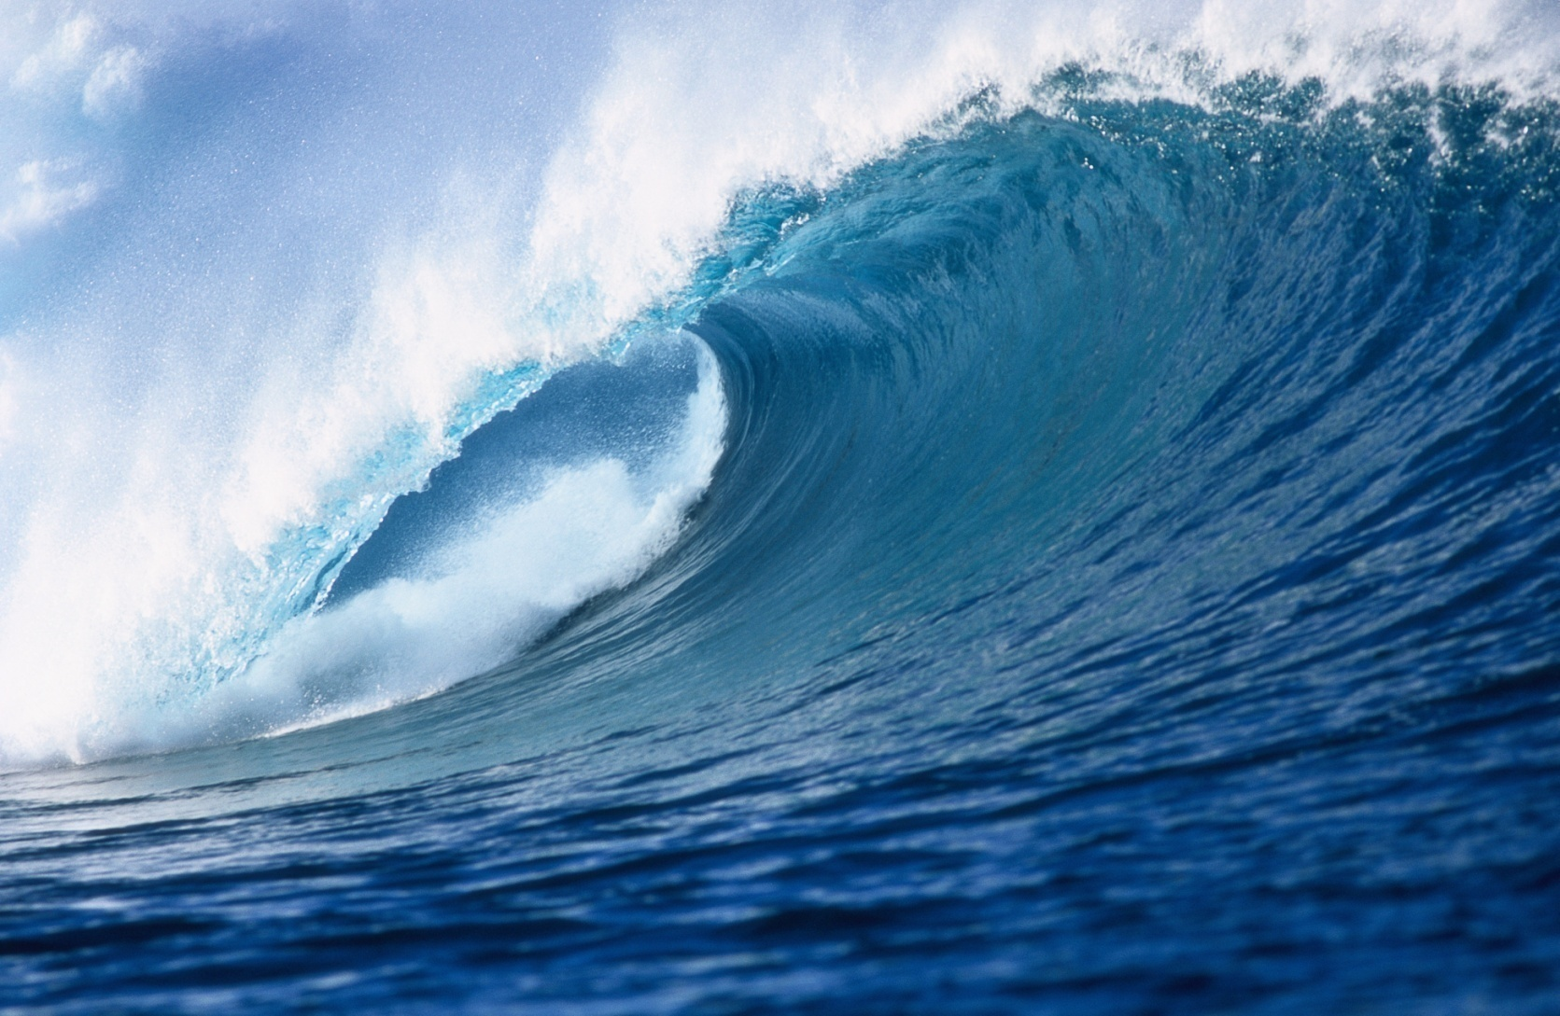
Wave energy

Slide 86
Wave energy
Caused due to transfer of energy by winds to sea.
Rate energy transfer depends on speed of wind and distance over which it interact.
Energy flux is much higher than solar and wind.
P α A² t (amplitude and period of motion)
Energy dissipated by friction.
Near coastline we can extract up to 2000000 MW
Wave power is usually expressed in kW/m

Slide 87
ADVANTAGES
Availability of large energy flux.
Predictability of wave conditions over period of days.

Slide 88
Disadvantages
Irregularity in wave patterns in amplitude, phase and direction which makes difficult for extraction efficiently.
System exposed to occasional extreme stormy conditions.
Peak power in deep sea wave cant extract.
Sophisticated systems needed.

Slide 89
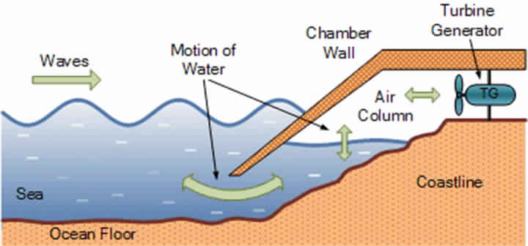

Slide 90
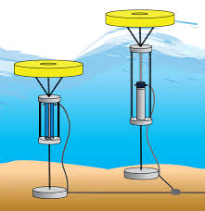

Slide 91
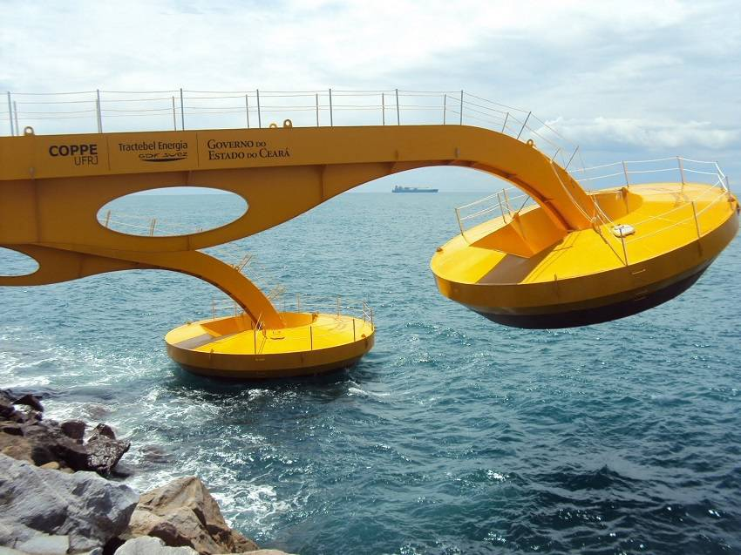

Slide 92
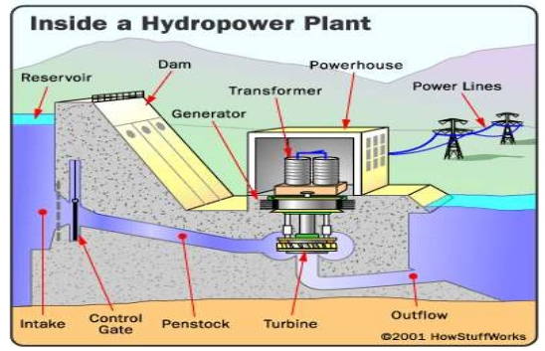
HYDROELECTRIC POWER PLANT

Slide 93
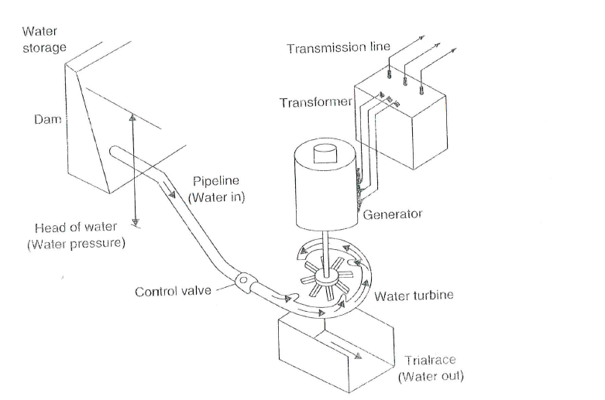
HYDROELECTRIC POWER PLANT

Slide 94
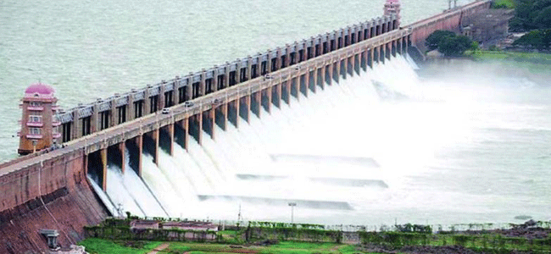
Components of Hydroelectric Plant
Reservoir with Dam

Slide 95
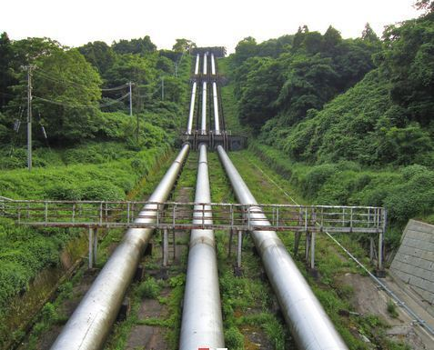
Penstock Pipe

Slide 96
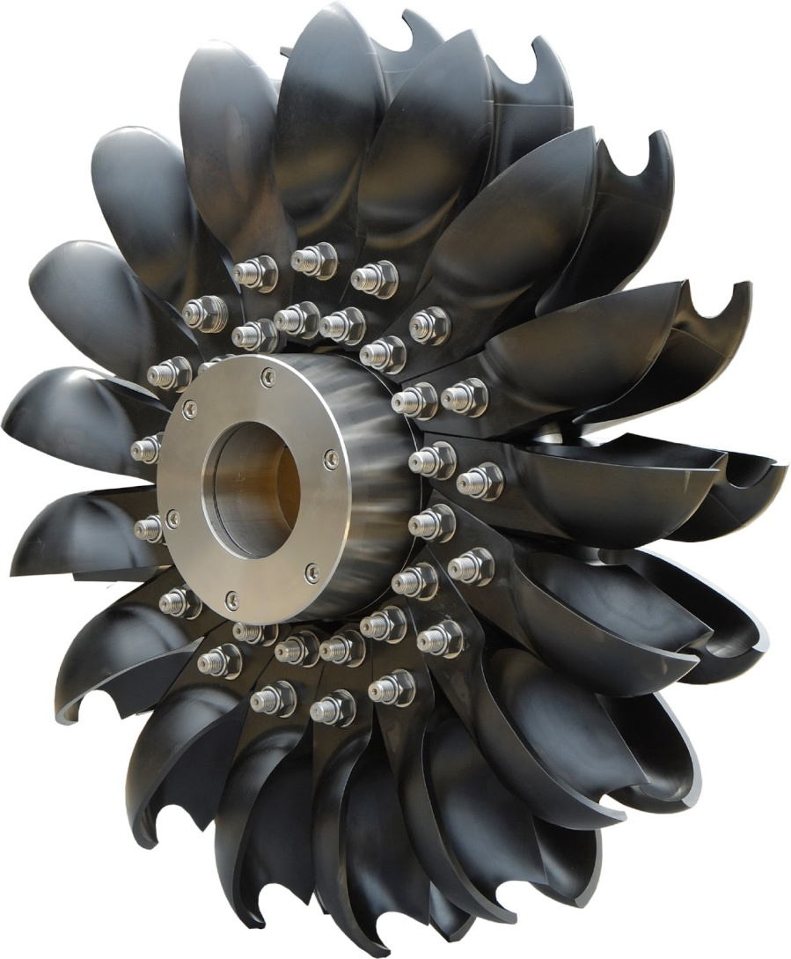
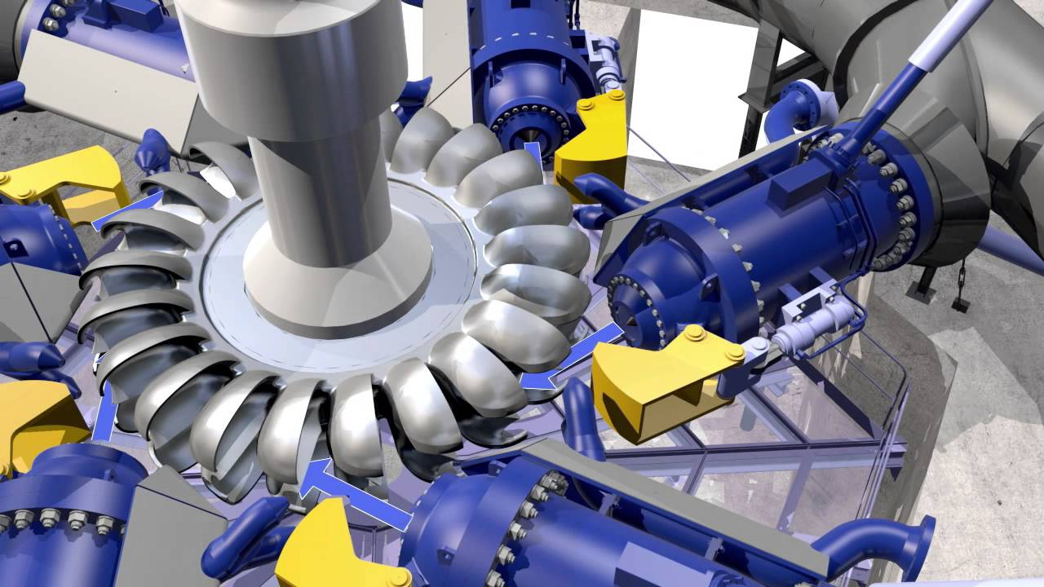
TURBINES- Pelton

Slide 97
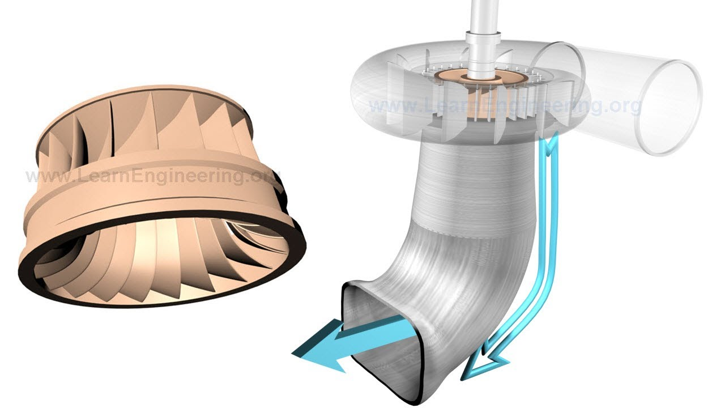
TURBINES - Francis

Slide 98
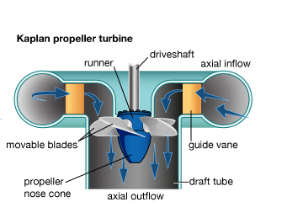
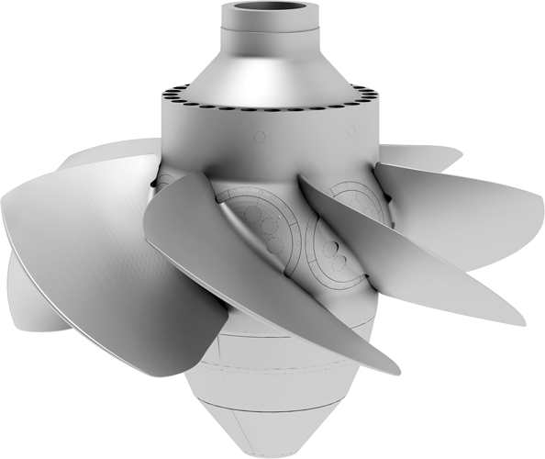
TURBINES - Kaplan

Slide 99
HYDROELECTRIC POWER PLANT
44,478.42 MW (13.92%)
70 places, 358 units.
Koyna, satara Maharashtra, 4 x 70, 4 x 80, 2 x 20, 4 x 80, 4 x 250 = 1,960MW
Srisailam Dam, Andhra Pradesh, 6 x 150, 7 x 110 = 1,670 MW.
Sharavathi, Karnataka 10 x 103.5, 2 x 27.5, 4 x 60, 4 x 13.2, 4 x 21.6 = 1,608.2 MW
In Karnataka, 3409MW, 4 places

Slide 100
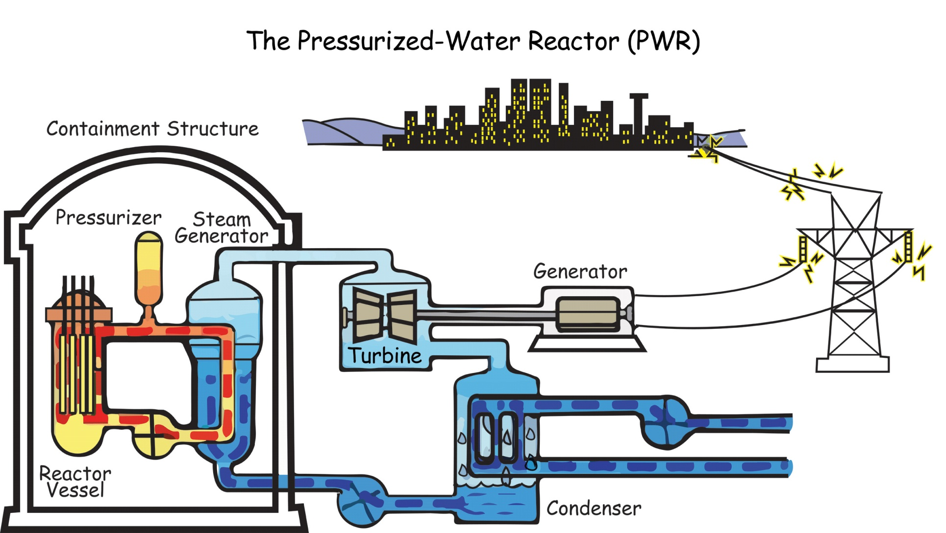
NUCLEAR POWER PLANT

Slide 101
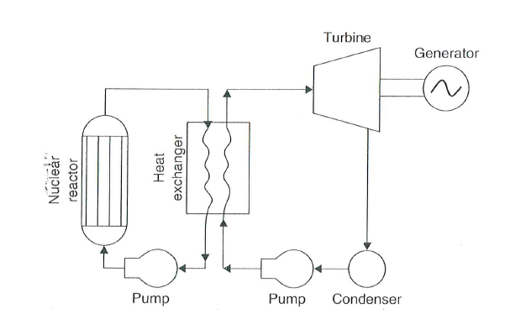
NUCLEAR POWER PLANT

Slide 102
NUCLEAR POWER PLANT
₉₂U²³⁵ , ₉₄Pu²³⁹ , ₉₂U²³³ are the fuels of nuclear reactors.
In the ore, ₉₂U²³⁵ only 0.7%, rest ₉₂U²³⁸ ,
₉₄Pu²³⁹ from ₉₂U²³⁸ , ₉₂U²³³ form ₉₀Th²³² during fission reaction.
Homogeneous reactor – U and C mixed homogeneously and used as rods or plates in the reactor
Heterogeneous reactors – fuel in the form of roads, while moderator(Aluminium, stainless steel or zirconium) surrounds- prevent oxidation.

Slide 103
MODERATOR
Moderator – reduce kinetic energy from 1 MeV (13200 km/s) to 0.25 eV (2200 m/s) for sustainable chain reaction.
Commonly used moderators include regular (light) water (roughly 75% of the world's reactors), solid graphite (20% of reactors) and heavy water (5% of reactors). Beryllium has also been used in some experimental types.
regular (light) water- enriched U plants.
solid graphite, heavy water and Beryllium- natural U.
Major characteristics – slow down neutrons, resistant to corrosion, high melting point, high chemical stability and should not absorb neutron.

Slide 104
Control Road – controlled, sustainable chain reaction.
High absorption capacity of neutrons.
Cadmium, boron or hafnium.
Shielding – 50 to 60 cm of steel plate – neutrons, gamma rays and other radiations in concrete wall and steel.
Reactor vessel – reactor core, shielding and reflector.

Slide 105
TYPES OF REACTOR
Neutron energy
Fast reactors
Thermal reactor
Fuel used
Natural fuel
Enriched Uranium
Moderator used
Water
Heavy water
graphite
Coolant used
Water cooled
Gas cooled

Slide 106
POWER FROM NUCLEAR POWER PLANT
6,780.00 MW (2.12 %)
8 places in India, 33 units of different capacity.
Nuclear Power Corporation of India Limited (NPCIL).
Tarapur Atomic Power Station, October 28, 1969 Tarapur Palghar Maharashtra , 1,400 MW.
TPA Station was constructed initially with two BWR units under the 1963, 123 Agreement between India, the United States, and the International Atomic Energy Agency (IAEA). It was built for the Department of Atomic Energy by GE and Bechtel. Units 1 and 2 were brought online for commercial operation on 28 October 1969 with an initial power of 210 MW of electricity. Later on this was reduced to 160 MW due to technical difficulties. These were the first of their kind in Asia.
Kaiga Nuclear Power Plant – 880 MW. (Karnataka)
Fusion Reactors- expected to generate power by 2030.

